Slide 1
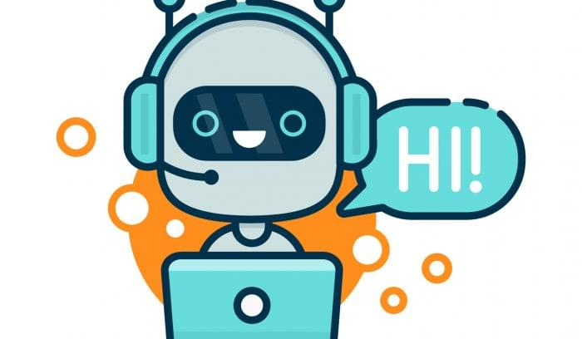
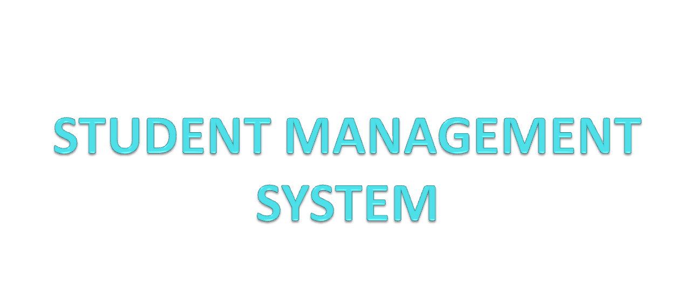
CHATBOT

Slide 2
Presented To: Ms. Shilpi Khanna
Presented By: (1) Prashant Upadhyay (1812213801) (2) Shivam Pandey(1712213069)

Slide 3
ABSTRACT
OBJECTIVE: The purpose of chat bots is to support and scale business teams in their relations with customers. It could live in any major chat applications like Facebook Messenger, Slack, Telegram, Text Messages, etc. ... Undoubtedly among them are Facebook Messenger, Snapchat, Whatsapp, WeChat etc.
Increase operational efficiency.
Automating customer request fulfillment.
Handling basic queries which is turn free employeesto work for complex & higher value inquiries.
Improve the response rate as well as customer engagement.
Notes:
3

Slide 4
REQUIREMENTS
Prepare the Dependencies. The first step in creating a chatbot in Python with the ChatterBot library is to install the library in your system.
Import Classes.
Create and Train the Chatbot.
Communicate with the Python Chatbot.
Train your Python Chatbot with a Corpus of Data.

Slide 5
WORK COMPLETED
STUDENT MANAGEMENT
Login- Login from user

Slide 6
WORK IN PROGRESS
Collection data e.g. details about project requirements.
The fundamental of HTML and CSS to design front end.

Slide 7
DIFFICULTIES
Front end design.
Customization of layout.

Slide 8
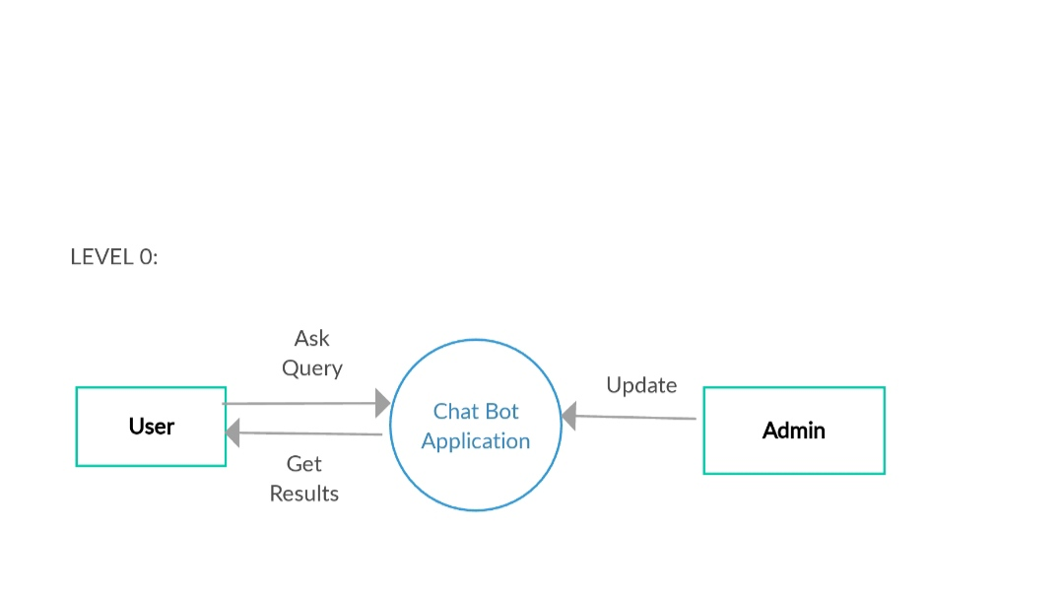
ZERO LEVEL DFD

Slide 9
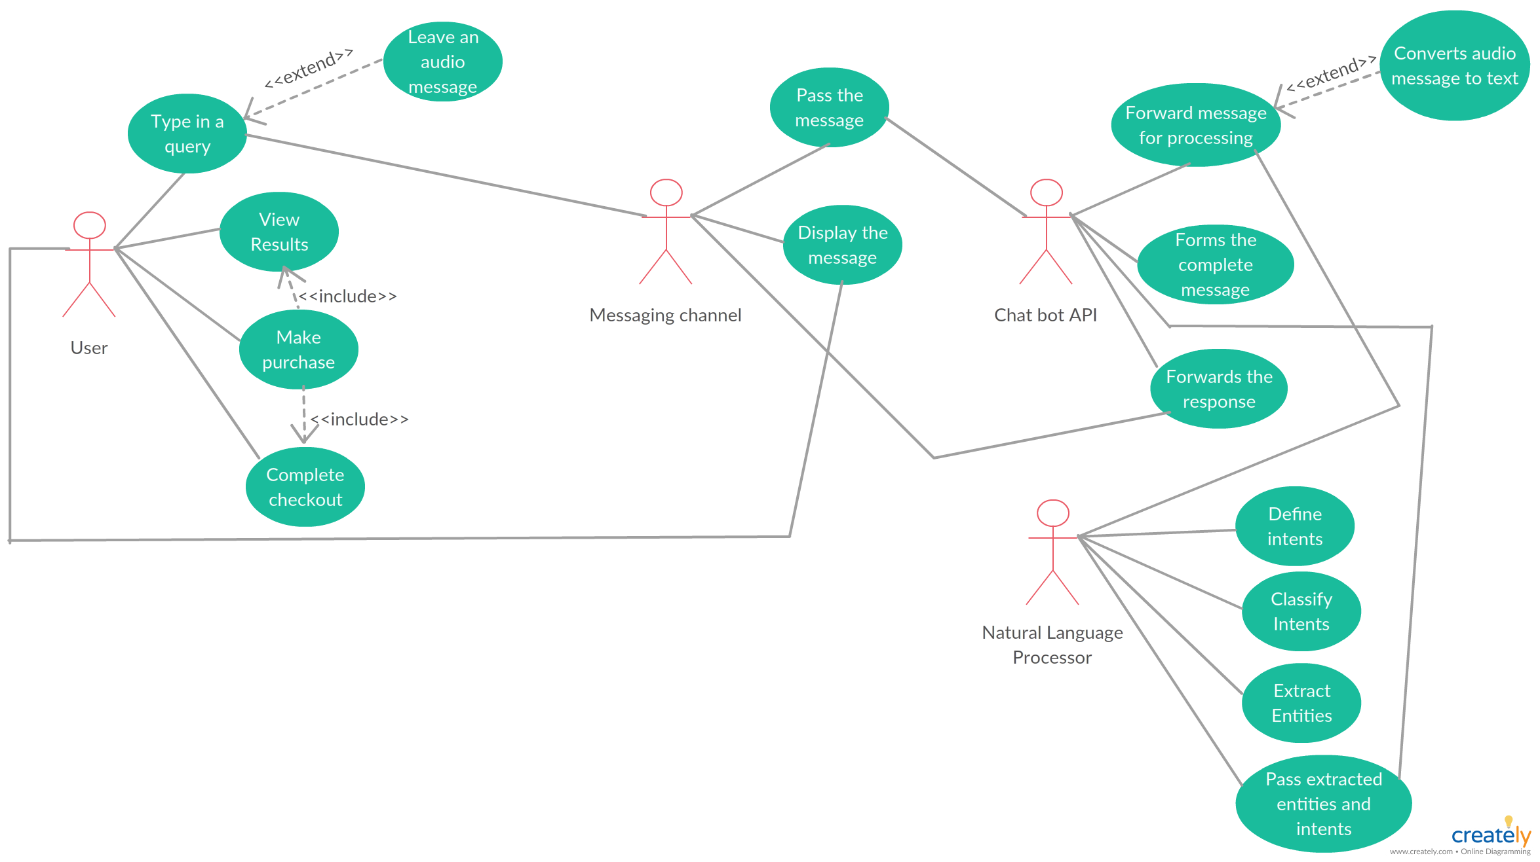
DFD(DATA FLOW DIAGRAM)

Slide 10
APPLICATIONS APPLICATIONS
(1) Increase availability time and response time as Chatbots supposed to work 365 days a year, 24 hours a day without any pay.
(2) After having top advantages, it also has a superior power that it has a low maintenance cost.
(3) know and understand the customers of a respective company.

Slide 11
ADVANTAGES
24-hour availability: Waiting for the next available operator for minutes is not a solved problem yet, but chatbots are the closest candidates to ending this problem.
Instant answers: An operator can concentrate on one customer at a time and answer one question.
Endless patience: While customer reps and customers sometimes lose their patience, that’s something bots are yet incapable of.

Slide 12
LIMITATIONS
(1) Chatbots don't understand human context. It is one of the significant limitations of chatbots. ...
(2)They can't make decisions.
(3)Chatbots have no emotions

Slide 13
THANKYOU

